Slide 1


Christopher J Donner
November 1st, 2025

Slide 2
Outline
Executive Summary
Introduction
Methodology
Results
Conclusion
Appendix

Slide 3
Executive Summary
Data collection was performed with a combination of web scraping techniques and the response from the public SpaceX APIs. This data was imported into Python using the Pandas library as a Dataframe and using built-in Pandas methods was cleaned of missing values resulting in easily accessed structured data.
The SpaceX Falcon 9 space craft has a re-usable booster0 component that can be landed and retrieved. This is done in several ways and there are key factors that can be used to predict the success of the retrieval process. This report delves into that.

Slide 4
Introduction
This project is investigating the over-all efficacy and predictability of launch and booster retrieval success using machine learning techniques.
How successful is the Falcon 9?
Are there factors to predict and potentially mitigate the failure of first-stage launch component retrieval?

Slide 5

Section 1

Slide 6
Methodology
Executive Summary
Data collection methodology:
Data was collected with a combination of SpaceX’s public facing APIs and scraping their wikapedia article
Perform data wrangling
Imported the data as a Pandas dataframe
Missing values for numeric columns were replaced with the mean of the column or dropped as needed.
Perform exploratory data analysis (EDA) using visualization and SQL
Imported the dataframe into a SQL table and wrote a number of queries to run against this database
Perform interactive visual analytics using Folium and Plotly Dash
Made data visualizations and a dashboard to visually explore the data findings
Perform predictive analysis using classification models
How to build, tune, evaluate classification models

Slide 7

Data Collection
Pulled historical launch data using SpaceX’s public API. Using the unique launch IDs, sent GET requests to the rockets, launchpads, cores and payload endpoints to build a comprehensive data set in a Pandas dataframe
Secondly, scraped the SpaceX Wikipedia page for corroborating launch details.
Put this dataframe into the form of a SQL table to be able to easily perform complex queries against it.

Slide 8

Data Collection – SpaceX API
Present your data collection with SpaceX REST calls using key phrases and flowcharts
Add the GitHub URL of the completed SpaceX API calls notebook https://github.com/christopherdonner/appliedDataScienceCapstone/blob/main/jupyter-labs-spacex-data-collection-api.ipynb as an external reference and peer-review purpose
/v4/rockets/
/v4/launches/past
Get the name of the rocket
List of launch IDs
json_normalize()
/v4/payloads/
Get the payload of the launch
/v4/launchpads/
Dataframe
Get the location of the launch
/v4/cores/
cleanup
Get the outcome of the core retrieval and details of the core

Slide 9
Data Collection - Scraping
Present your web scraping process using key phrases and flowcharts
https://github.com/christopherdonner/appliedDataScienceCapstone/blob/main/jupyter-labs-webscraping.ipynb

Slide 10
Data Wrangling
Describe how data were processed
You need to present your data wrangling process using key phrases and flowcharts
https://github.com/christopherdonner/appliedDataScienceCapstone/blob/main/labs-jupyter-spacex-Data%20wrangling.ipynb

Slide 11
EDA with Data Visualization
Plotted correlations between launch site, booster type, payload as they pertain to success of launch and booster retrieval
https://github.com/christopherdonner/appliedDataScienceCapstone/blob/main/spacex_dash_app.py

Slide 12
EDA with SQL
Retrieved a comprehensive collection of stats, facts and figures
This is detailed later in the rerport
https://github.com/christopherdonner/appliedDataScienceCapstone/blob/main/jupyter-labs-eda-sql-coursera_sqllite.ipynb

Slide 13
Build an Interactive Map with Folium
Showcased launch site proximity to coast lines and distance from urban centers
https://github.com/christopherdonner/appliedDataScienceCapstone/blob/main/lab_jupyter_launch_site_location.ipynb

Slide 14
Build a Dashboard with Plotly Dash
Summarize what plots/graphs and interactions you have added to a dashboard
Explain why you added those plots and interactions
https://github.com/christopherdonner/appliedDataScienceCapstone/blob/main/spacex_dash_app.py

Slide 15
Predictive Analysis (Classification)
Separated the data into training and testing at a 1:4 ratio
Trained models using Logistic Regression, K-Nearest Neighbour and Grid Search and scored them

Slide 16
Results
Exploratory data analysis results
Interactive analytics demo in screenshots
Predictive analysis results

Slide 17

Section 2

Slide 18
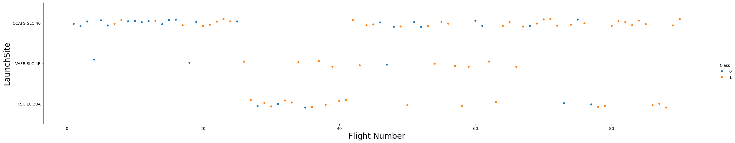
Flight Number vs. Launch Site
Show a scatter plot of Flight Number vs. Launch Site
Show the screenshot of the scatter plot with explanations

Slide 19
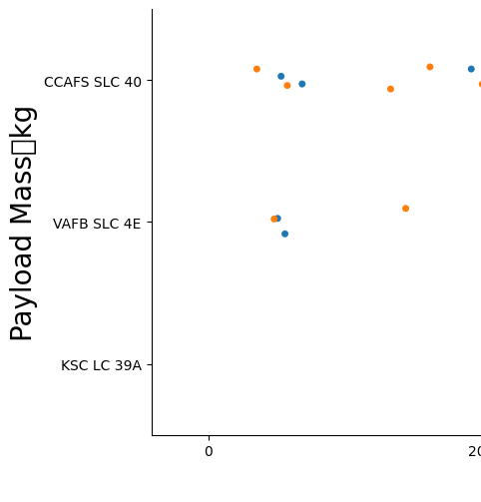
Payload vs. Launch Site
Show a scatter plot of Payload vs. Launch Site
Show the screenshot of the scatter plot with explanations

Slide 20
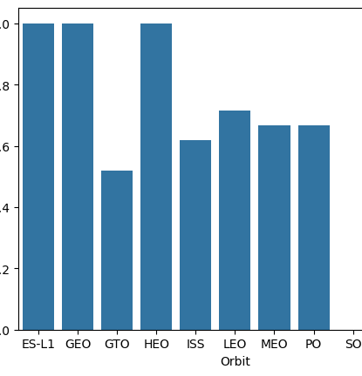
Success Rate vs. Orbit Type
Show a bar chart for the success rate of each orbit type
Show the screenshot of the scatter plot with explanations

Slide 21
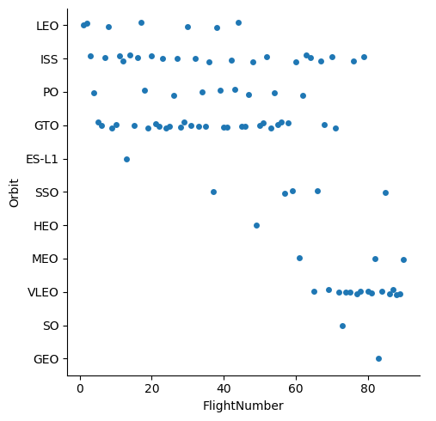
Flight Number vs. Orbit Type
Show a scatter point of Flight number vs. Orbit type
Show the screenshot of the scatter plot with explanations

Slide 22
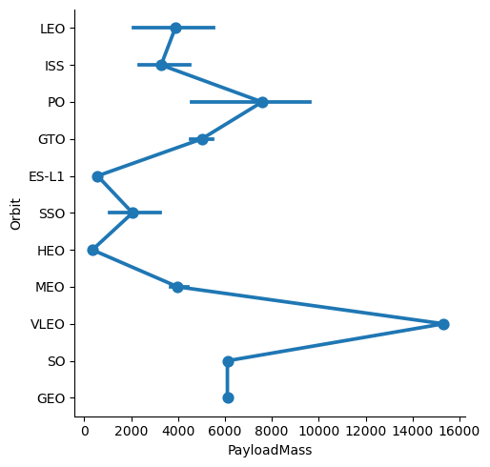
Payload vs. Orbit Type
Show a scatter point of payload vs. orbit type
Show the screenshot of the scatter plot with explanations

Slide 23
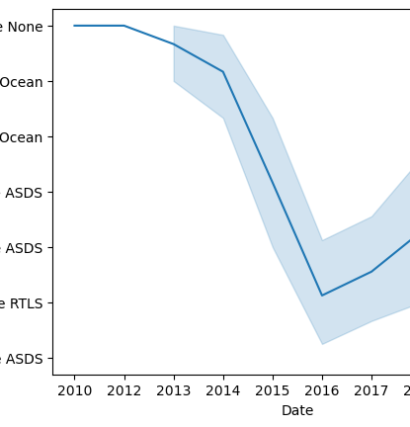
Launch Success Yearly Trend
Show a line chart of yearly average success rate
Show the screenshot of the scatter plot with explanations

Slide 24
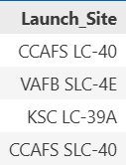
All Launch Site Names
sql select distinct "Launch_Site" from SPACEXTABLE

Slide 25
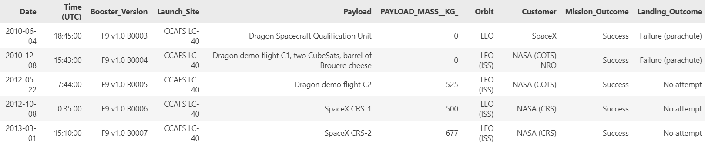
Launch Site Names Begin with 'CCA'
sql select * from SPACEXTABLE where "Launch_Site" like 'CCA%' limit 5

Slide 26
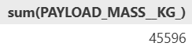
Total Payload Mass
Calculate the total payload carried by boosters from NASA
sql select sum(PAYLOAD_MASS__KG_) from SPACEXTABLE where Customer="NASA (CRS)"

Slide 27
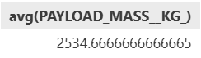
Average Payload Mass by F9 v1.1
Calculate the average payload mass carried by booster version F9 v1.1
sql select avg(PAYLOAD_MASS__KG_) from SPACEXTABLE where Booster_Version like 'F9 v1.1%'

Slide 28
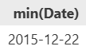
First Successful Ground Landing Date
Find the dates of the first successful landing outcome on ground pad
sql select min(Date) from SPACEXTABLE where Mission_Outcome = "Success" and Landing_Outcome = "Success (ground pad)"

Slide 29
Successful Drone Ship Landing with Payload between 4000 and 6000
List the names of boosters which have successfully landed on drone ship and had payload mass greater than 4000 but less than 6000
sql select * from SPACEXTABLE where Mission_Outcome = Landing_Outcome like 'Success (drone%' and (PAYLOAD_MASS__KG_ > 4000 and PAYLOAD_MASS__KG_ < 6000)

Slide 30
Total Number of Successful and Failure Mission Outcomes
Calculate the total number of successful and failure mission outcomes
sql select count(*) from SPACEXTABLE where Mission_Outcome like "Success%“
Success: 90

Slide 31
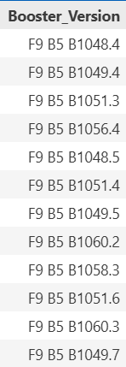
Boosters Carried Maximum Payload
List the names of the booster which have carried the maximum payload mass
sql select booster_version from SPACEXTABLE where payload_mass__kg_ = (select max(payload_mass__kg_) from SPACEXTABLE)

Slide 32
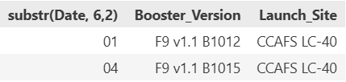
2015 Launch Records
List the failed landing_outcomes in drone ship, their booster versions, and launch site names for in year 2015
sql select substr(Date, 6,2), Booster_Version, Launch_Site from SPACEXTABLE where Landing_Outcome = 'Failure (drone ship)' and substr(Date,0,5)='2015'

Slide 33
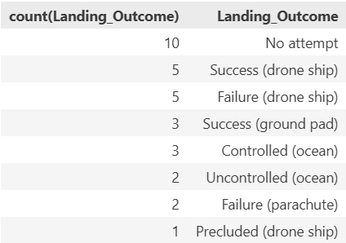
Rank Landing Outcomes Between 2010-06-04 and 2017-03-20
sql select count(Landing_Outcome), Landing_Outcome from SPACEXTABLE where Date between '2010-06-04' and '2017-03-20' group by Landing_Outcome order by count(Landing_Outcome) desc

Slide 34

Section 3

Slide 35
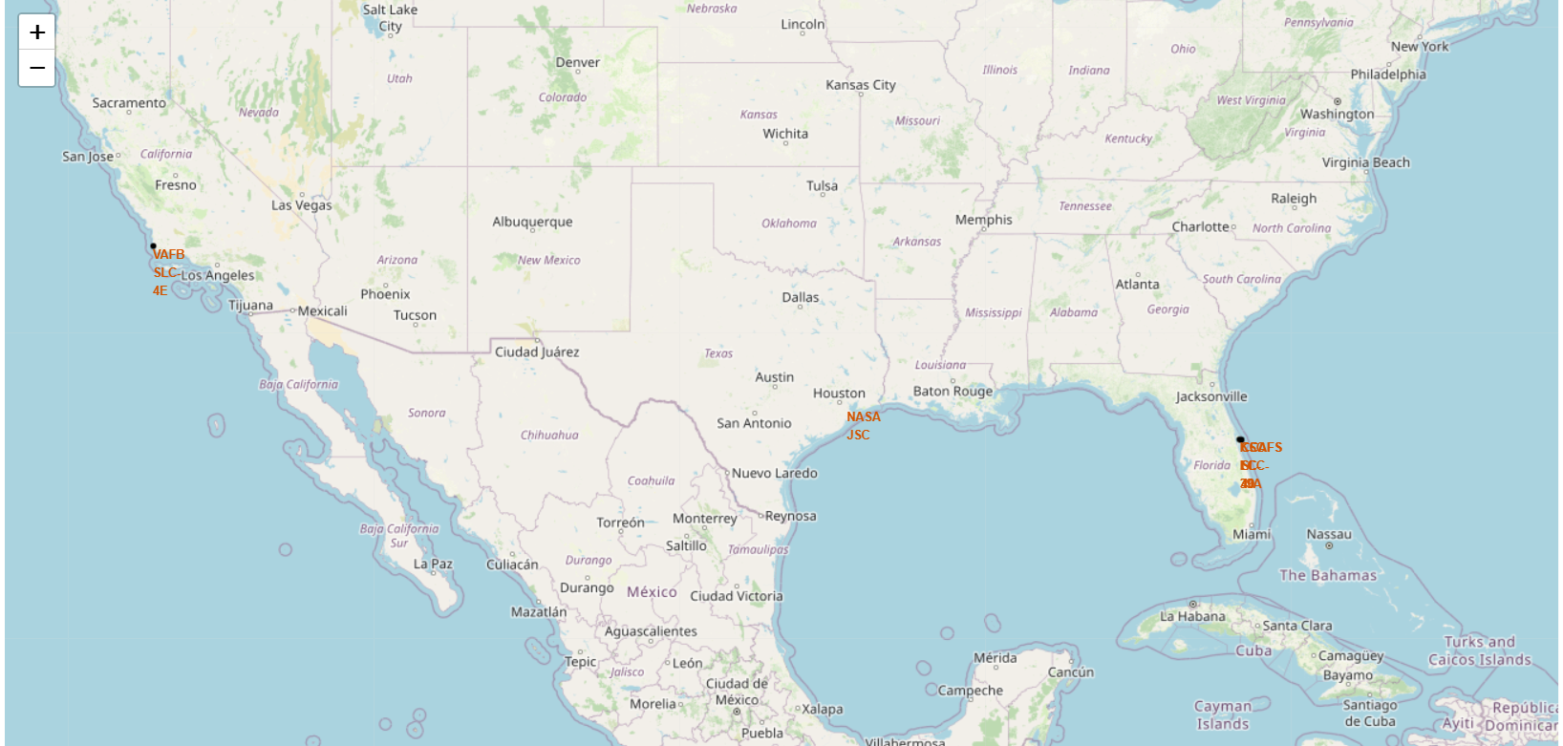
Interactive map of all launch sites
Replace <Folium map screenshot 1> title with an appropriate title
Explore the generated folium map and make a proper screenshot to include all launch sites’ location markers on a global map
Explain the important elements and findings on the screenshot

Slide 36
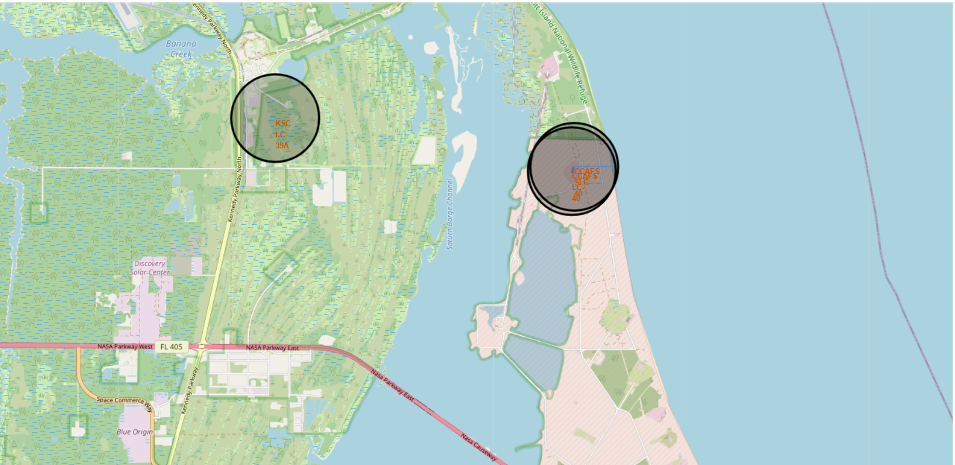
Showing distance from launch site to nearest coastline
Replace <Folium map screenshot 3> title with an appropriate title
Explore the generated folium map and show the screenshot of a selected launch site to its proximities such as railway, highway, coastline, with distance calculated and displayed
Explain the important elements and findings on the screenshot

Slide 37
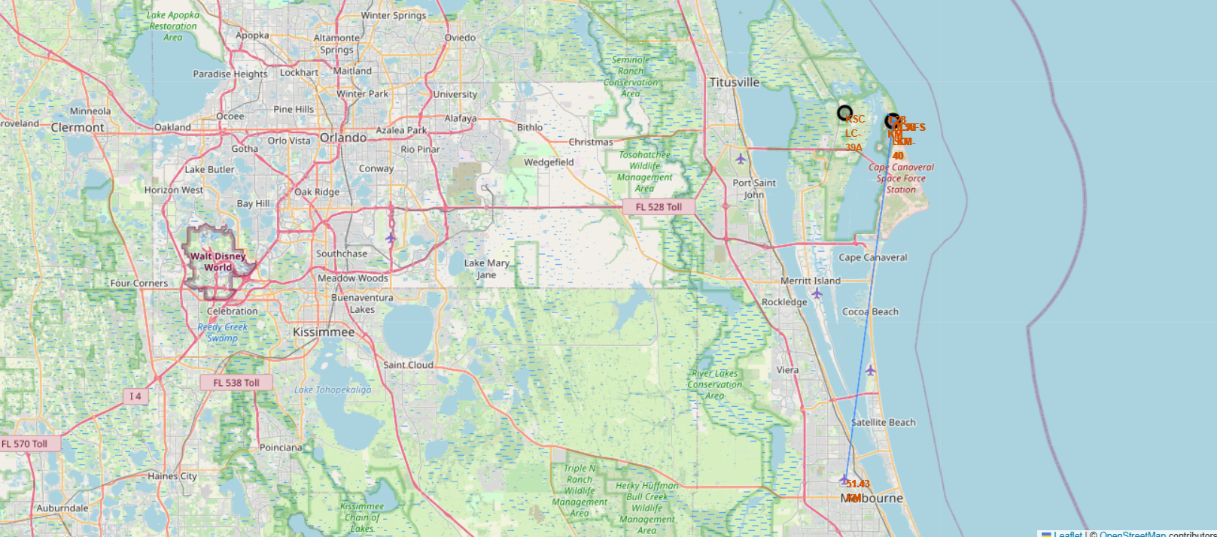
Distance to closest city
Replace <Folium map screenshot 2> title with an appropriate title
Explore the folium map and make a proper screenshot to show the color-labeled launch outcomes on the map
Explain the important elements and findings on the screenshot

Slide 38

Section 4

Slide 39
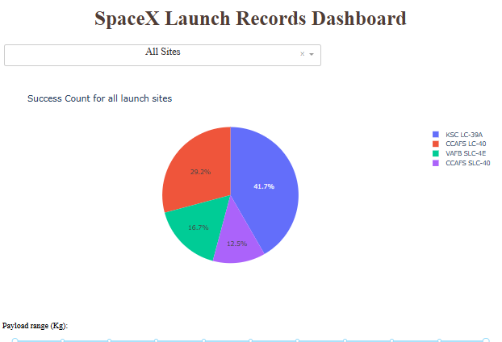
Success Count for all launch sites

Slide 40
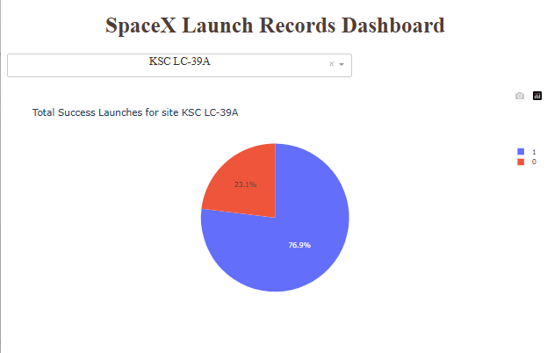
Site with the highest success rate

Slide 41
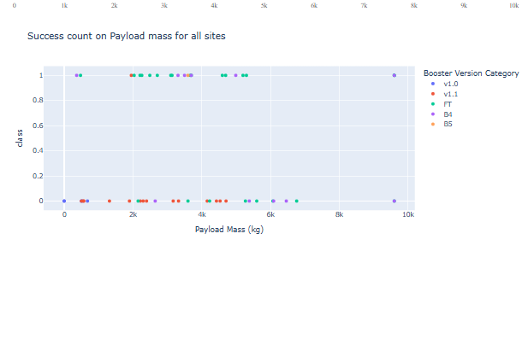
Payload vs success per booster version for all sites

Slide 42

Section 5

Slide 43
Classification Accuracy
Visualize the built model accuracy for all built classification models, in a bar chart
Logistic Regression: accuracy : 0.8333333333333334
Grid Search: accuracy: 0.8333333333333334
K-Nearest Neighbour: accuracy: 0.8333333333333334

Slide 44

Confusion Matrix
Show the confusion matrix of the best performing model with an explanation

Slide 45
Conclusions
Point 1
Point 2
Sites are stragetically placed away from cities but close to highways and coastlines
Logstic Regression, K-Nearest Neighbour and Grid Search all perform roughly the same in this scenario.
…

Slide 46
Appendix
Include any relevant assets like Python code snippets, SQL queries, charts, Notebook outputs, or data sets that you may have created during this project

Slide 47


